Slide 1
THE FORMATION OF A MEANDER
A river rarely flows in a straight line – it will bend around something in its course, e.g. a tree or hard rock. This results in areas of slower and faster water movement. The river flows faster on the outside and erodes the outside bends of the river channel by the processes of hydraulic action and abrasion – this forms a river cliff. The river flows more slowly on the inside bend of a river channel and deposits some of its load – this forms a river beach. Continuous erosion on the outer bank and deposition on the inner bank forms a meander in the river. Over time, meanders become larger and more recognisable.
Word bank: meander, channel, outside, beach, cliff, hydraulic, inside, rarely, abrasion, bend, course, movement, channel, deposits, deposition

Slide 2
MEANDERS - RIVER CLIFFS & RIVER BEACHES
River cross section
6:
3:
5:
2:
1:
4:
Word bank: River beach, River cliff, River flows fast, Sand deposited on inside of bend, River flows slowly, River bank on outside of bend is undercut by erosion

Slide 3
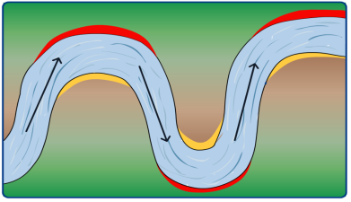
MEANDERS
Task: Sort out and annotate the 4 stages of a river meander.
Task 1: Circle what process (erosion or deposition) is happening at the outside and inside of a river bend. Task 2: What river features are shown at location 1 and 2.
erosion or deposition ?
outside of
river bend
1.
outside of
river bend
1.
2.
2.
inside of
river bend
inside of
river bend
erosion or
deposition ?
erosion or
deposition ?
erosion or deposition ?
inside of
river bend
Key
1: River beach or river cliff ?
2: River beach or river cliff ?
2.
outside of
river bend
1.
BIRD’S-EYE VIEW
OF A RIVER
erosion or deposition ?

Slide 4
MEANDERS
Task: Sort out and annotate the 4 stages of a river meander.
Task 1: Circle what process (erosion or deposition) is happening at the outside and inside of a river bend. Task 2: What river features are shown at location 1 and 2.
erosion or deposition ?
outside of
river bend
1.
outside of
river bend
1.
2.
2.
inside of
river bend
inside of
river bend
erosion or
deposition ?
erosion or
deposition ?
erosion or deposition ?
inside of
river bend
Key
1: River beach or river cliff ?
2: River beach or river cliff ?
2.
outside of
river bend
1.
BIRD’S-EYE VIEW
OF A RIVER
erosion or deposition ?

