Slide 1
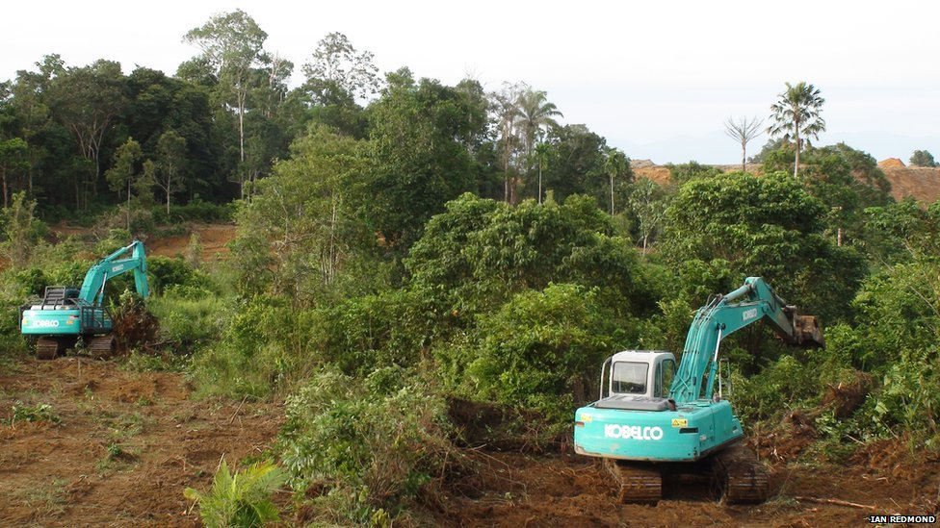

Slide 2
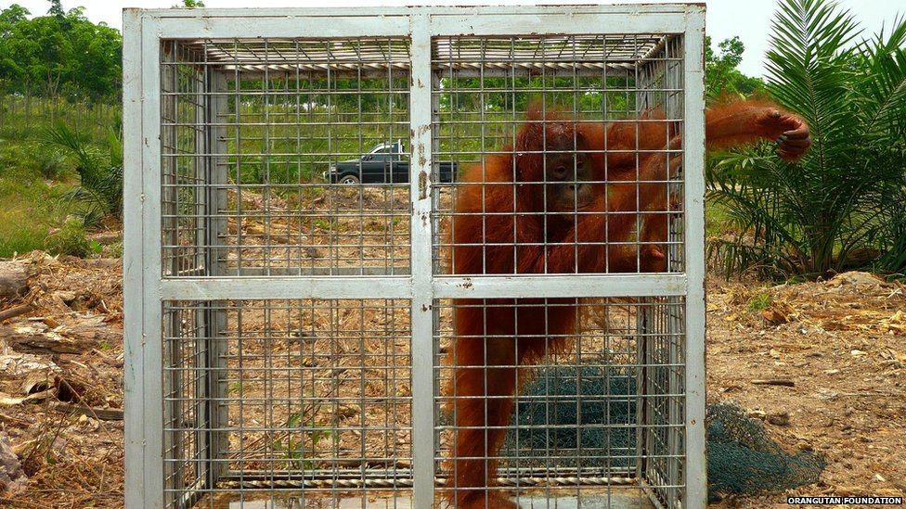

Slide 3
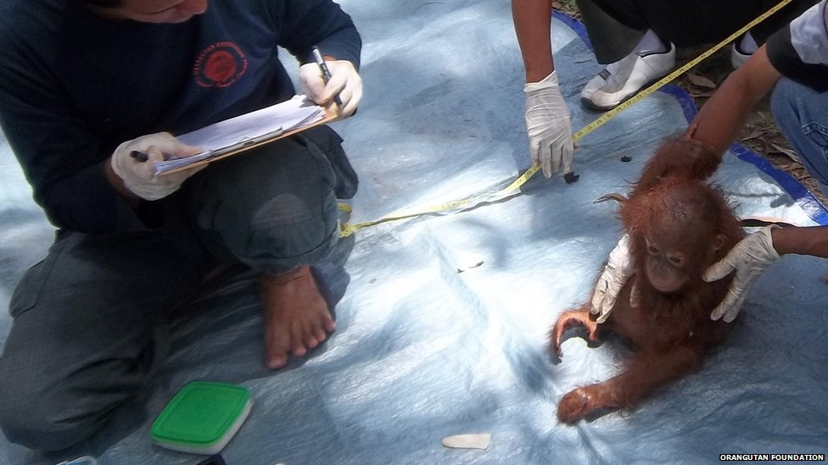

Slide 5
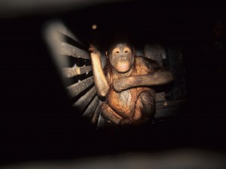

Slide 6
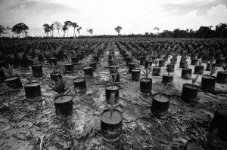

Slide 7
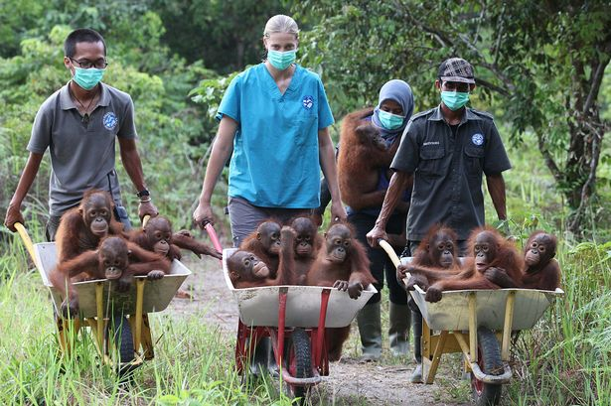

Slide 8
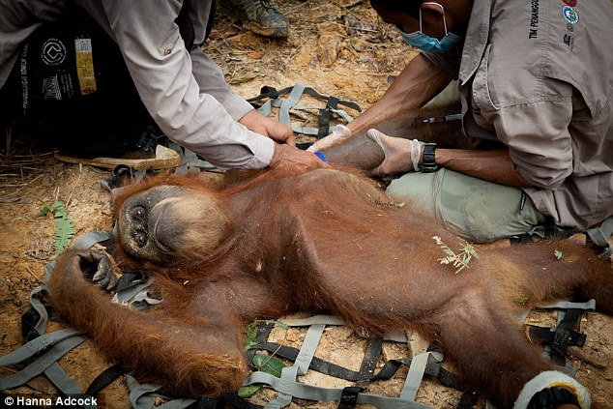

Slide 9
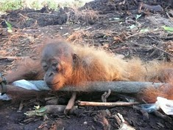

Slide 10
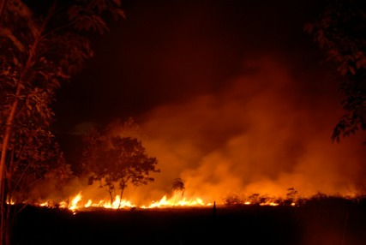

Slide 11
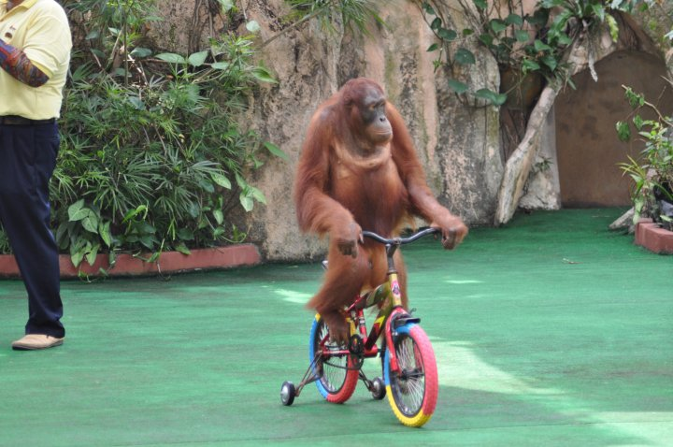

Slide 12
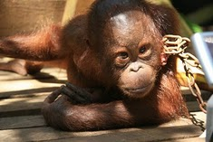

Slide 13
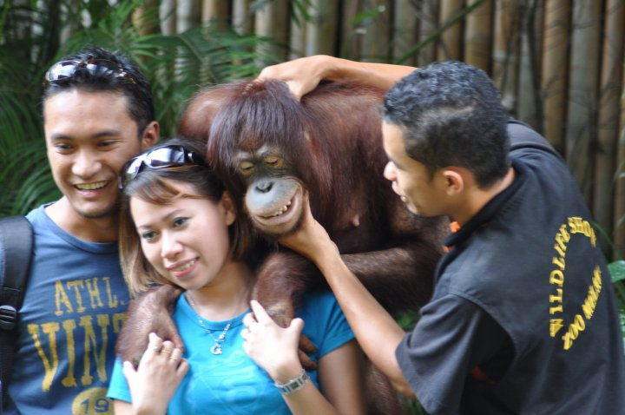

Slide 14
Your task…
To produce a piece of writing about orang-utans.
An information text about the species which will include facts about their habitat, where they live in the world, diet, behaviour, physical characteristics. You can also include fun facts and statistics to interest the reader.
A piece to communicate the threats and dangers orang-utans face in the wild. You will need to include information about deforestation, illegal pet trade, palm oil and poaching.
A piece of writing which includes information about both of the above.

Slide 15
First steps…
Choose your focus and begin to takes notes from the fact sheets provided.
Don’t copy sentences – just key information
Try to take notes about one area at a time – use sub headings to organise your work.
Write on the sheets – underline anything you know you want to include and don’t want to forget.
Use technical vocabulary relevant to the topic. You want to show that you know what you’re talking about and the language you use will make that clear.

