Slide 1
Decimals and Fractions
Introduction to one place decimals
Objectives
Day 1
Know that 1-place decimal numbers represent ones and tenths.
Day 2
Divide 2-digit numbers by 10 to create 1-place decimal numbers.
Day 3
Multiply 1-place decimals to give whole numbers.
Notes:
Before teaching, be aware that:
On Day 1 children will need mini-whiteboards and pens. You also need three pieces of A1 paper (one should be folded into ten strips, ready to be cut), scissors. Instructions for the practical activity are in the notes for Slide 7.
On Day 2 children will need mini-whiteboards and pens. You can also use the ‘Moving Digits’ ITP to model further examples of division by 10.
On Day 3 children will need mini-whiteboards and pens. The activities can also be modelled using children to hold up digit cards when multiplying by 10 and a physical function machine made from a cardboard box.

Slide 2
Decimals and Fractions
Introduction to one place decimals
Starters
Day 1
Count in ¹/₄s (simmering skills)
Day 2
Divide multiples of 10 by 10 (pre-requisite skills)
Day 3
Count in ¹/₁₀s to at least 2 (pre-requisite skills)
Notes:
Choose starters that suit your class by dragging and dropping the relevant slide or slides below to the start of the teaching for each day.

Slide 3
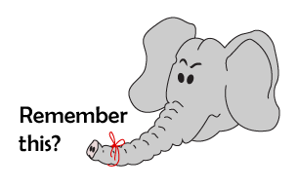
Decimals and Fractions
Introduction to one place decimals
Starter
Count in ¹/₄s
Notes:
Simmering skills – to use this starter, drag this slide to the start of Day 1
Sketch a line from 0 to 5, whole numbers labelled and 1/4s marked but not labelled. Point to various places on the line and ask children what number goes there. Include 11/2, drawing out two 1/4s = 1/2. Count along the line: 0, 1/4, 1/2, 3/4, 1, 11/4, 1½ … 5.

Slide 4
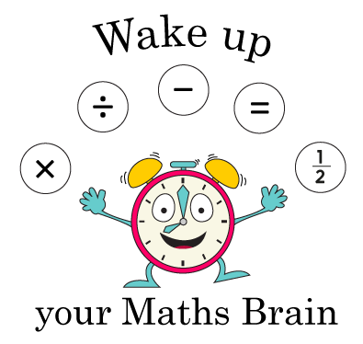
Decimals and Fractions
Introduction to one place decimals
Starter
Divide multiples of 10 by 10
Notes:
Pre-requisite skills – to use this starter, drag this slide to the start of Day 2
Show children 3-digit multiples of 10, e.g. 560. Ask them to divide the number by 10 and show the answer using place value cards, e.g. 56. Repeat with different numbers. What happens to each digit when we divide by 10? Encourage children to write the answer almost as soon as you have shown the multiple of 10.

Slide 5
Decimals and Fractions
Introduction to one place decimals
Starter
Count in ¹/₁₀s to at least 2
Notes:
Pre-requisite skills – to use this starter, drag this slide to the start of Day 3
Use the counting stick to count in steps of 1/10 from 0 to 1 and back again. Point to 5/10. How else can we say this fraction? Repeat, this time counting from 1 to 2 in 1/10s.

Slide 6
Decimals and Fractions
Introduction to one place decimals
Objectives
Day 1
Know that 1-place decimal numbers represent ones and tenths.

Slide 7
Day 1: Know that 1-place decimal numbers represent ones and tenths.
How many pieces of paper do I have?
Let’s cut this piece into tenths.
Notes:
Show children two pieces of A1 paper (one should be folded into ten equal strips, ready to be cut). How many pieces of paper do I have? Two. I am going to cut one piece into tenths.
Ask two children to hold the piece of paper and cut it along the folds. Once it is cut in half, others can help cut each half into five strips.
Show the ten strips of paper. How many equal parts have we cut the whole piece into? What fraction of the whole is each strip? Agree that each one is a tenth.
The pictures on the following slides can also be shown with the actual cut up strips.

Slide 8
Day 1: Know that 1-place decimal numbers represent ones and tenths.
How many equal strips has the whole piece of paper been cut into?
What fraction of the whole is each piece?
.
10s | 1s | 0.1s
.
1
0
1
¹/₁₀ = 0.1
…. Move one place to the right when dividing by 10.
We can divide 1 by 10 on a place value grid...
Notes:
DO NOT UNDERESTIMATE THE IMPORTANCE OF THE LEARNING ON THIS SLIDE.
CHILDREN’S UNDERSTANDING OF THESE RELATIONSHIPS AND EQUIVALENCES FORM THE BASIS OF ALL FURTHER WORK ON DECIMALS.

Slide 9
Day 1: Know that 1-place decimal numbers represent ones and tenths.
What fraction of the whole piece of paper is here?
Write it on your whiteboard as a decimal.
How much is here now? Write it on your whiteboards as a decimal.
And now?

Slide 10
Day 1: Know that 1-place decimal numbers represent ones and tenths.
And now?
How much is here? Write it on your whiteboards as a decimal.
And now?
Notes:
Children can now go on to do differentiated GROUP ACTIVITIES. You can find Hamilton’s group activities in this unit’s TEACHING AND GROUP ACTIVITIES download on our website.
WT: Dice game collecting and adding tenths (with support).
ARE/GD: Dice game collecting and adding tenths.

Slide 11
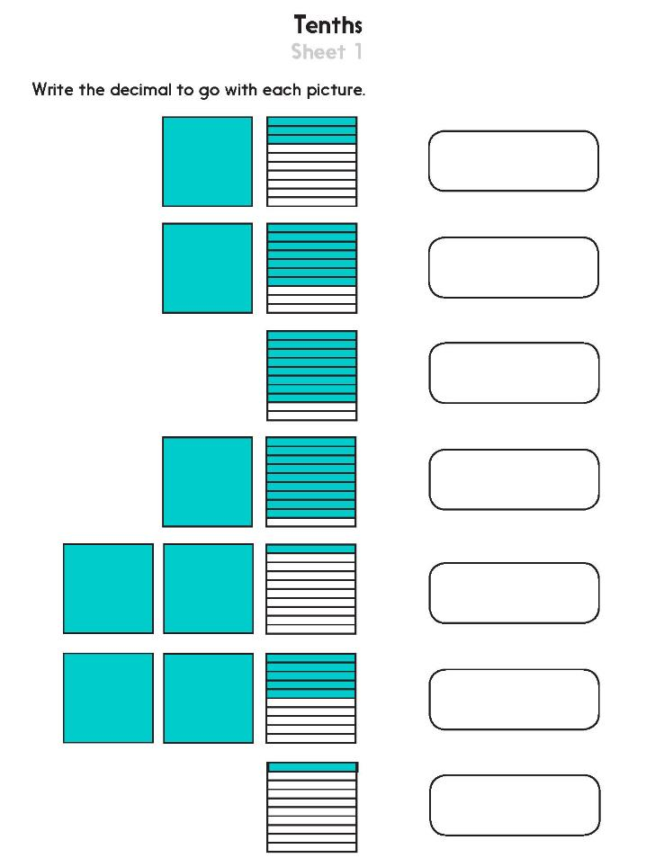
Challenge
Notes:
The Practice Sheet on this slide is suitable for most children.
You can download differentiated PRACTICE WORKSHEETS from Hamilton’s website in this unit’s PROCEDURAL FLUENCY box.
WT: Tenths Sheet.
ARE: Tenths Sheet.
GD: Tenths Sheet.

Slide 12
Decimals and Fractions
Introduction to one place decimals
Objectives
Day 2
Divide 2-digit numbers by 10 to create 1-place decimal numbers.

Slide 13
Day 2: Divide 2-digit numbers by 10 to create 1-place decimal numbers.
.
100s | 10s | 1s | 0.1s
Let’s divide 56 by 10 on this place value grid.
.
5
6
5
6
Watch what happens to the digits.
What is the place value of the 6 now?

Slide 14
Day 2: Divide 2-digit numbers by 10 to create 1-place decimal numbers.
.
100s | 10s | 1s | 0.1s
Divide 27 by 10. Write the answer on your whiteboard.
.
2
7
2
7
Let’s check...
.
Now 49 ÷ 10.
Write the answer on your whiteboard.
100s | 10s | 1s | 0.1s
.
4
9
4
9
Let’s check...
What happened to the digits each time?

Slide 15
Day 2: Divide 2-digit numbers by 10 to create 1-place decimal numbers.
.
100s | 10s | 1s | 0.1s
Now 435 ÷ 10.
Write the answer on your whiteboard.
.
4
3
5
5
4
3
Let’s check...
All three digits move one place to the right.
.
100s | 10s | 1s | 0.1s
.
4
0
9
4
0
9
Now 409 ÷ 10.
Write the answer on your whiteboard.
Let’s check...

Slide 16
Day 2: Divide 2-digit numbers by 10 to create 1-place decimal numbers.
.
100s | 10s | 1s | 0.1s
Let’s divide 40 by 10. Write the answer on your whiteboard.
.
4
0
0
4
4
Let’s check...
What if we divide by 10 again? Write the answer on your whiteboard.
Each time we divided by 10, the digit 4
moved one place to the right.

Slide 17
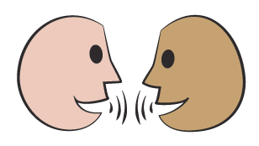
Day 2: Divide 2-digit numbers by 10 to create 1-place decimal numbers.
Place Value Chart
Talk to your partner – what patterns can you see in the digits in this Place Value Chart?
What happens to the digit 5 when we
multiply it by 10?
And divide by 10?
Notes:
Today would be a great day to use the problem-solving investigation – Magical Square Decimals – as the group activity, which you can find in this unit’s IN-DEPTH INVESTIGATION box on our website.
Alternatively, children can now go on to do differentiated GROUP ACTIVITIES. You can find Hamilton’s group activities in this unit’s TEACHING AND GROUP ACTIVITIES download on our website.
WT: Move digit cards on a place value grid to divide 2-digit numbers by 10.
ARE: Move digit cards on a place value grid to divide 2-digit numbers by 10.
GD: Move digit cards to divide 2-digit numbers by 1.0

Slide 18
Investigation: Adult Sheet
Notes:
Today would be a great day to use this problem-solving investigation – Magical Square Decimals – as the group activity, which you can find in this unit’s IN-DEPTH INVESTIGATION box on Hamilton’s website.

Slide 19
Investigation: Child Sheet
Notes:
Today would be a great day to use this problem-solving investigation – Magical Square Decimals – as the group activity, which you can find in this unit’s IN-DEPTH INVESTIGATION box on Hamilton’s website.

Slide 20
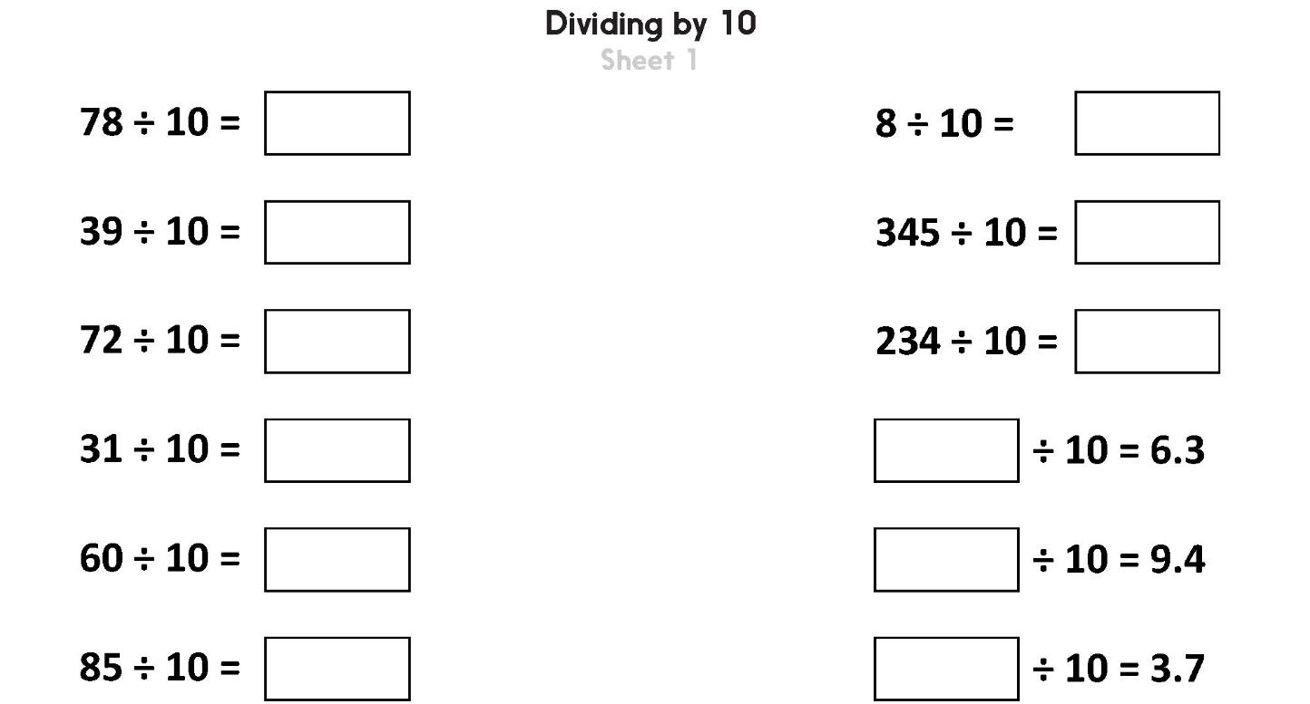
Challenge
Notes:
The Practice Sheet on this slide is suitable for most children.
You can download differentiated PRACTICE WORKSHEETS from Hamilton’s website in this unit’s PROCEDURAL FLUENCY box.
WT: Dividing by 10, use digit cards on a place value grid to help.
ARE/GD: Dividing by 10, use a calculator to check.

Slide 21
Decimals and Fractions
Introduction to one place decimals
Objectives
Day 3
Multiply 1-place decimals to give whole numbers.

Slide 22
Day 3: Multiply 1-place decimals to give whole numbers.
2
2
5
.
5
Let’s see...
What will happen to the digit cards when we multiply 2.5 by 10?
The DIGITS moved one place to the left.
THE DECIMAL POINT DIDN’T MOVE!

Slide 23
Day 3: Multiply 1-place decimals to give whole numbers.
For each of these numbers write the new position for the digit cards when the number is multiplied by 10.
5
5
1
.
1
4
4
7
.
7
The decimal point never moves when we multiply by 10!
6
0
.
6

Slide 24
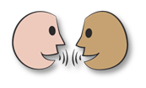
Day 3: Multiply 1-place decimals to give whole numbers.
254
308
25.4
18
30.8
77
1.8
7.7
× 10
Can you predict the answer when the numbers go through the machine?
The function machine multiplies by 10.

Slide 25
Day 3: Multiply 1-place decimals to give whole numbers.
Let’s check…
34.2
3.7
5.6
342
37
× 10
56
÷ 10
We can divide by 10!
How can we reverse the function?
Try 56 ÷ 10 and 342 ÷ 10.
25
Year 3
Notes:
Children can now go on to do differentiated GROUP ACTIVITIES. You can find Hamilton’s group activities in this unit’s TEACHING AND GROUP ACTIVITIES download on our website.
WT: Use a function machine to multiply and divide numbers by 10.
ARE/GD: Play bingo to practise multiplication and division of numbers by 10.

Slide 26
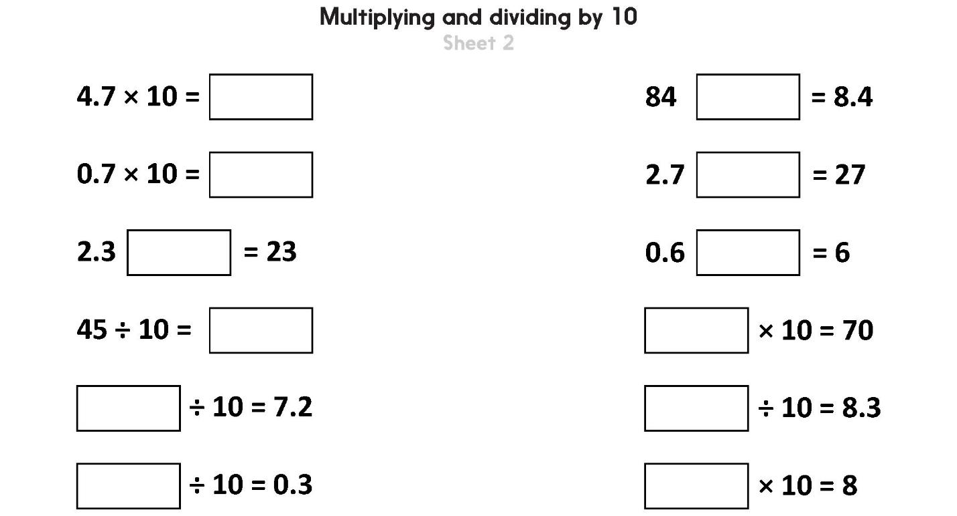
Challenge
Notes:
The Practice Sheet on this slide is suitable for most children.
You can download differentiated PRACTICE WORKSHEETS from Hamilton’s website in this unit’s PROCEDURAL FLUENCY box.
WT: Multiplying by 10.
ARE/GD: Multiplying and dividing by 10 Sheet 2.

Slide 27
Decimals and Fractions
Introduction to one place decimals
Well Done! You’ve completed this unit.
Objectives
Day 1
Know that 1-place decimal numbers represent ones and tenths.
Day 2
Divide 2-digit numbers by 10 to create 1-place decimal numbers.
Day 3
Multiply 1-place decimals to give whole numbers.
Notes:
You can now use the Mastery: Reasoning and Problem-Solving questions to assess children’s success across this unit. Go to the next slide.

Slide 28
Problem solving and reasoning questions
Complete each sentence:
(a) 3.4 x 10 = _____
(b) 65 ÷ 10 = _____
(c) _____ ÷ 10 = 12.3
(d) _____ x 10 = 81
Draw a function machine which divides by 10
Write the output for these three numbers: 13 5 92
Write the input if 0.6 is the output.
Write the input if 2.2 is the output.
Write each fraction as a decimal number:
• One whole and six tenths
• ²²/₁₀
• Five wholes and one tenth
• ⁴/₁₀

Slide 29
Problem solving and reasoning questions answers
Complete each sentence:
(a) 3.4 x 10 = 34
(b) 65 ÷ 10 = 6.5
(c) 123 ÷ 10 = 12.3
8.1 x 10 = 81
Check on a place value grid if children are unsure of these.
Draw a function machine which divides by 10 Write the output for these three numbers: 13 5 92 1.3, 0.5 and 9.2 respectively. Write the input if 0.6 is the output. 6. Write the input if 2.2 is the output. 22. As in previous question these can be checked on a place grid. For the latter two the answers can be found by multiplying by 10 (i.e. the inverse function). Children who give answers 0.60 and 2.20 are mistakenly ‘adding a zero’ rather than moving the digits.
Write each fraction as a decimal number:
• One whole and six tenths 1.6
• ²²/₁₀ 2.2
• Five wholes and one tenth 5.1
• ⁴/₁₀ 0.4

