Slide 1
Year 3 – Spring Term
Mass & Capacity

Slide 2
Year 3 – Spring Term
Mass

Slide 3
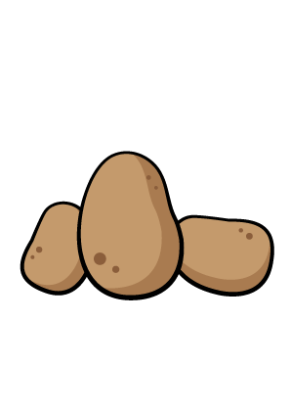
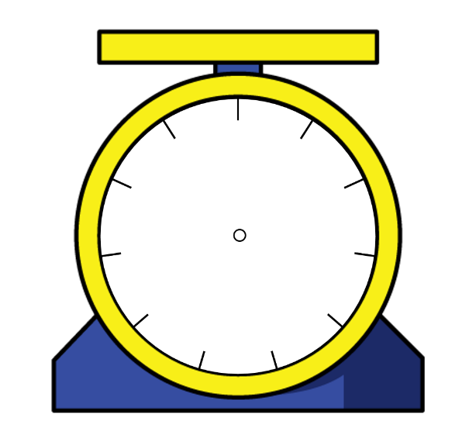
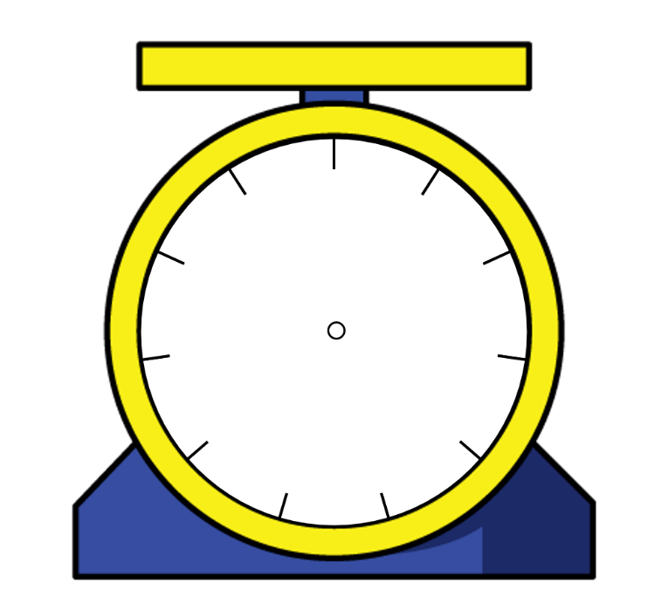
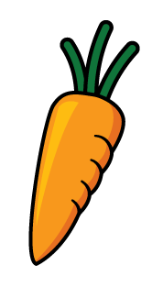
Who do you agree with? Explain why.
Amir
Jack
Rosie
Can you calculate the weight of the potatoes? Explain how you did it.
0
0
1
100
10
10
The potatoes weigh 13 kg
90
20
9
2
80
g
30
8
g
3
We don’t know how much the potatoes weigh because the number is hidden.
70
7
4
40
6
5
0
60
50
10
kg
g
0
0
1
100
0
10
10
10
The potatoes weigh more than half of 10 kg
9
2
90
20
g
8
g
3
80
g
30
7
4
70
40
6
5
60
50

Slide 4
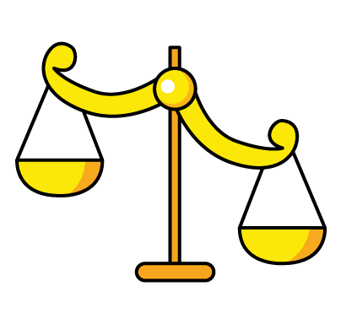
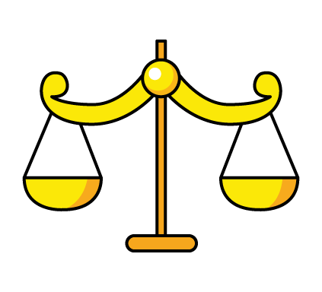
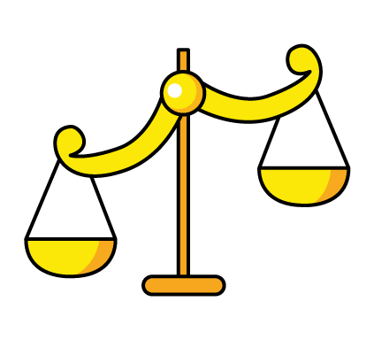
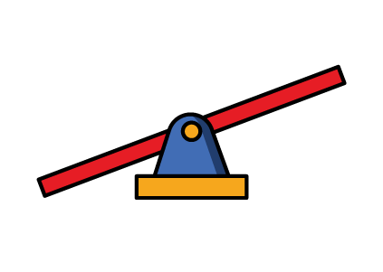
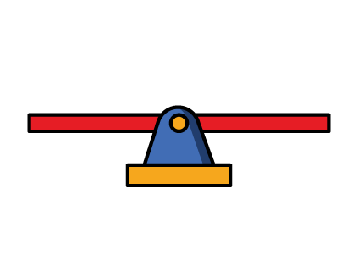
The chocolate bar weighs 100 g.
How much does one muffin weigh?
How much does each side weigh?

Slide 5
Using only 3 objects and a weighing scale, try to get as close to 2 kg as possible.
Explain why you chose those objects.
Work out how much more or how much less is needed to make it 2 kg.

Slide 6
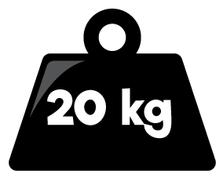
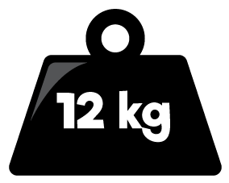
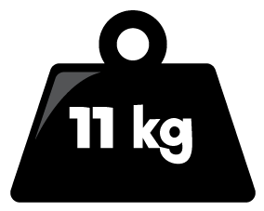
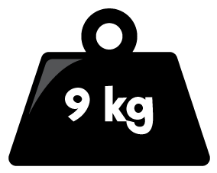
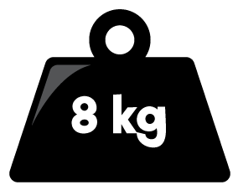
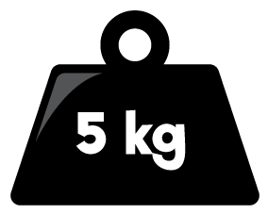
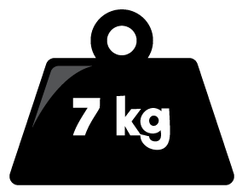
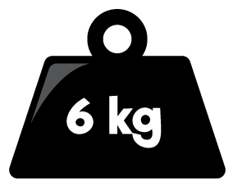
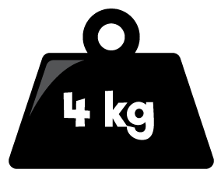
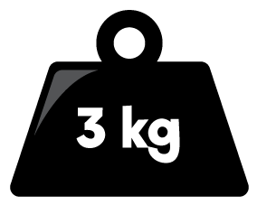
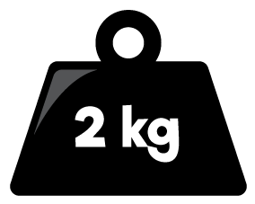
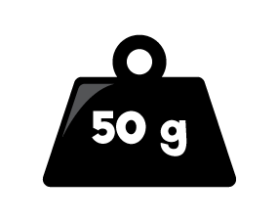
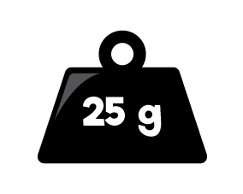
Here is a balance. Here is another.
Work out the value of

Slide 7
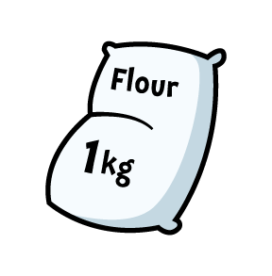
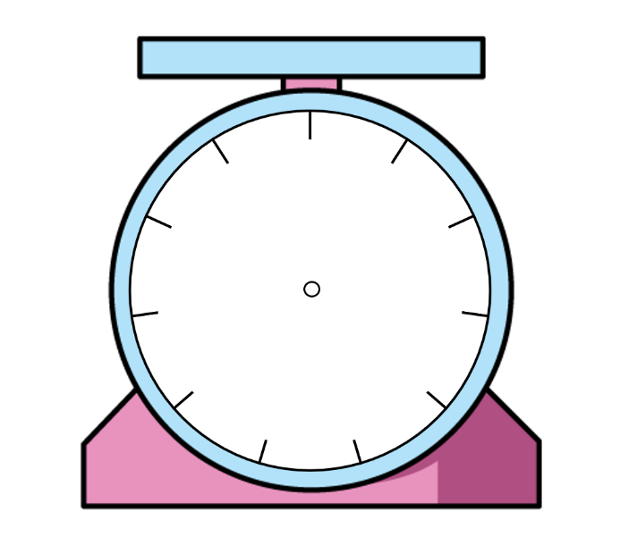
Three children are weighing potatoes and flour.
Who do you agree with? Explain your answer.
The flour weighs more because 2 kg is more than 700 g.
The flour weighs less because 2 is less than 700
1000
0
100
10
0
1
900
200
9
2
800
g
300
8
g
3
g
kg
700
400
7
4
600
500
6
5
The potatoes weigh more because the arrow is further than the arrow on the flour scale.

Slide 8
Here are three masses.
Match each mass to the correct child.
20 kg and 600 g
18 kg and 500 g
20 kg
My mass weighs more than $\frac{1}{2}$ of 40 kg.
Dora
My mass is more than Eva’s mass.
Mo
My mass weighs more than 18 kg but less than 20 kg.
Eva

Slide 9
Year 3 – Spring Term
Capacity

Slide 10
Use a variety of containers.
Can you estimate how much liquid they hold?
Check your estimates using measuring jugs and cylinders to see how accurate you were.

Slide 11
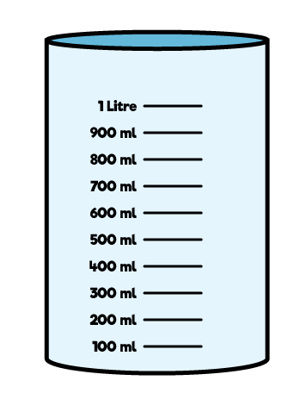
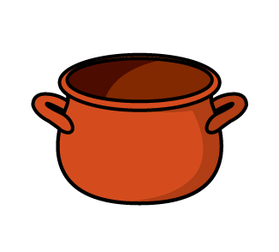
Amir and Alex work out the capacity of the pot by filling it with water, then pouring the water into the measuring cylinders.
Who do you agree with? Explain why.
The capacity of the pot is 302 ml
Amir
The capacity of the pot is 2 l and 300 ml.
Alex

Slide 12
True or False?
The tallest container has the largest capacity.
Use containers to decide whether the statement is true or false.
Record the capacity of the different containers in a table.

Slide 13
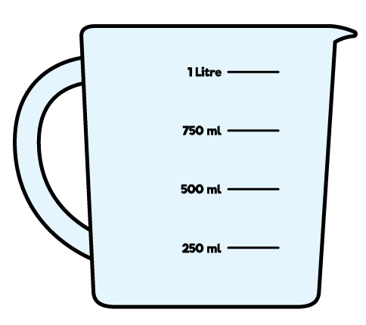
Is Eva correct? Explain your answer.
I know container 1 has more than container 2 in it because the water goes further up the side.
Eva
Container 1
Container 2

Slide 14
Here are some measuring cylinders.
The total liquid in all three cylinders is 400 ml.
Cylinder A has half of the total amount in it. Cylinder B has 67 ml less than Cylinder A.
How much liquid does each cylinder contain?
A
B
C

